Slide 1
UX project- Optimization of a website
Made by – George Lazarov

Slide 2
Content

Slide 3
Short summary of the project
This UX project is related to the analysis and research of the website zaplata.bg, along with its main competitor - jobs.bg, as well as the five most successful websites in the world in the same category - jobs and employment. Through the applied heuristic and competitive analyzes, this project will uncover the problems of zaplata.bg, their solutions and recommendations for providing a better website to the user base. This project is the product of the assignment given to me through the UX online course at udemy.com, created by Brendan Bolton-Klinger.

Slide 4
Competitive analysis
Through a competitive analysis done by the site pro.similarweb.com, I managed to find the five most used websites in the field of employment and jobs, to see how they work, whether they cover all the evaluative points with which zaplata.bg will be evaluated and what can be taken and applied from these best websites to zaplata.bg ● indeed.com – The American version of jobs.bg, dominates the US marketplace for job seeking and employment websites with a monthly visit of 270.5m people, of which 57.60% are in the United States. ● Glasdoor.com – Again American, with a monthly visit of 54.95m. people, of which 81.01% are from the United States. ● hh.ru – The main Russian website, offering job listings with a monthly visit of 40.11m. people of which, 90.24% are in the Russian Federation. ● mynavi.jp – The main Japanese website serving 38.64m. people a month, of which 97.91% are in Japan. ● naukri.com – The main Indian site for job seeking and employment, with a monthly visit of 30.53m. people , of which 93.94% are in India.

Slide 5
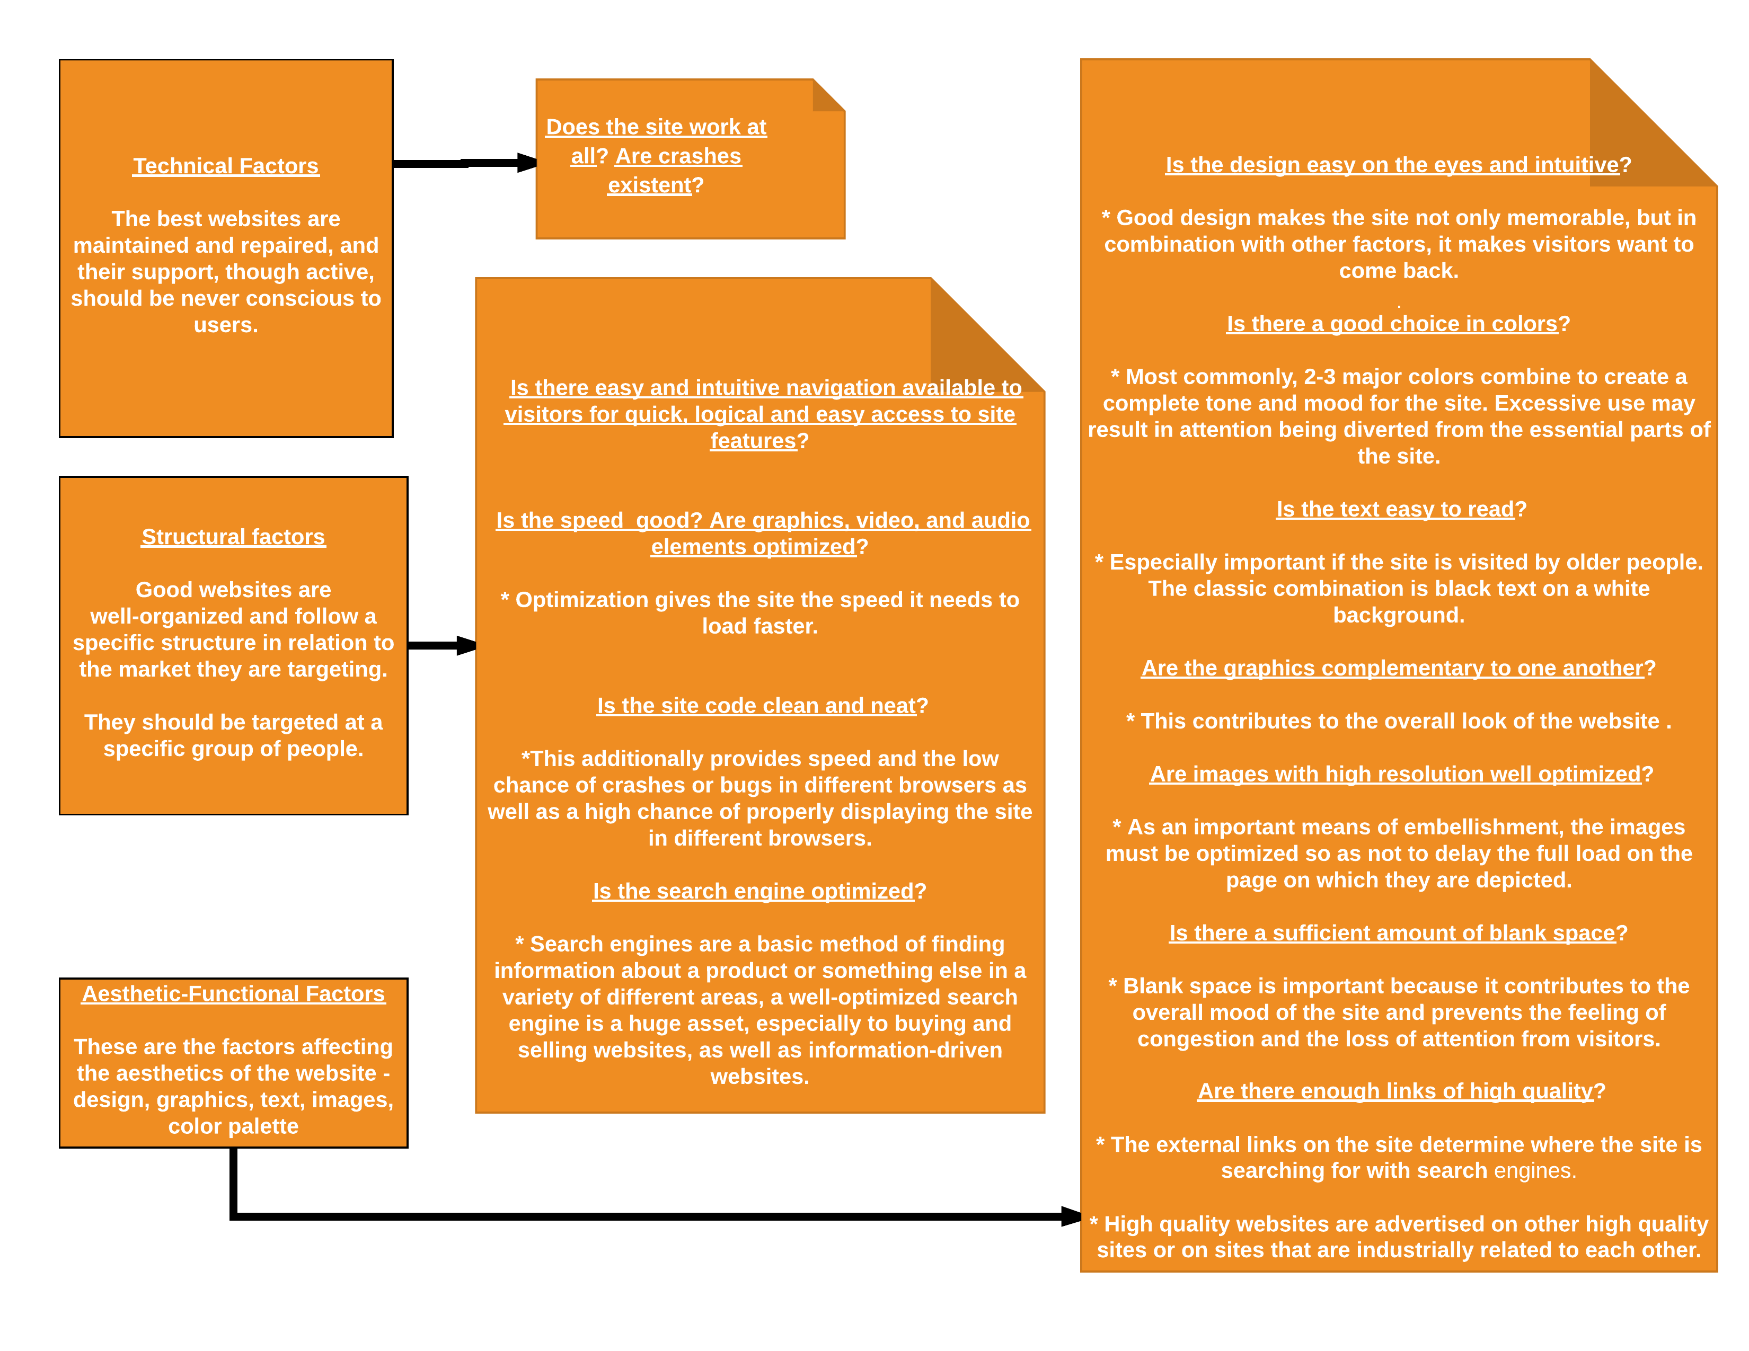
The elements needed for a good website:

Slide 6
Speed test
I did a mid-speed test through the website - gtmetrix.com; This site, in addition to the boot rate information on the main page of the website, also provides information directly related to the overall technical structure - assessing how well the site is made using A-F gradings; The site evaluates to what extent and how well are impelemented coding languages such as: JS, CSS, as well as different elements and characteristics like the server structural elements, image characteristics, resources, etc. (Test Region: Vancouver - Canada, via Firefox desktop browser) The analysis showed the following: Comparative scale - the average boot speed of google.com (2.0s) ● indeed.com - 2.1s ● glassdoor.com - 8.4s ● hh.ru - 13.2s ● jobs.bg - 7.8s ● mynavi.jp - 4.7s ● zaplata.bg - 7.6s ● naukri.com - 5.9s

Slide 7
In the results shown, we need to include the regional context that in the countries where they are most used, the sites would boot faster (the exception makes glassdoor.com) The results show that the websites give their visitors a good loading speed , as a clear winner is indeed.com, while glasdoor.com has a mediocre speed connection with its 8.4s. Other statistics: ● The average visit time per user for these five sites is 5.76m.
● The average visit rate is 6.74 pages / visit.

Slide 8
After an in-depth analysis of the above mentioned factors, the five sites, as hh.ru was more difficult to analyze because of the lack of English language optimization on the site, the cumulative information I divide into three parts:
Common strengths
Common/ individual weaknesses
● Locally good page loading speed (exception - glassdoor.com) ● Good organization and specific functional structure. ● Easy user orientation, such as overall design and navigation, is beneficial to visitors (exception mynavi.jp) ● Well structured and functional code. ● The aesthetic-functional elements are good - the color palette does not hurt the attention or the ability to work on the part of the users, the text is in a good font and does not hurt the eyes during long reading, according to gtmetrix, the images on the main page of the websites are well optimized and they don’t damage the overall speed of the sites. (Exception - indeed.com, where these image elements are largely missing.) ● Each search engine on the site is at a relatively good level and finds relatively accurate results. (Exception is indeed.com, whose search engine is extremely high). ● All five sites have mobile apps for android and apple that are supported and upgraded.
● The speed of glassdoor.com and hh.ru - according to gtmetrix analysis and the successive tips suggested by them, these two sites must seriously minimize the number of redirects on the main page, which is the main reason for their slow loading. ● At mynavi.jp there is a large slide space on the main page that advertises and explains the site's functions, which is useless, it can be replaced with a large logo and several keywords below so it briefly and clearly relays the same message, along with the fact that a logo is lighter on loading on the main page than a whole unnecessary high-resolution image slider. "There is also a partial English version of the site where there are unnecessary advertisements in Japanese, albeit the overall functional structure of the website is usable for English speaking users. ● Mediocre mobile search engine (filters that do not make it easier to search for job ads, there is a lack of user support (Naukri.com, glassdoor.com ), according to a number of dissatisfied user reviews on the Android website.

Slide 9
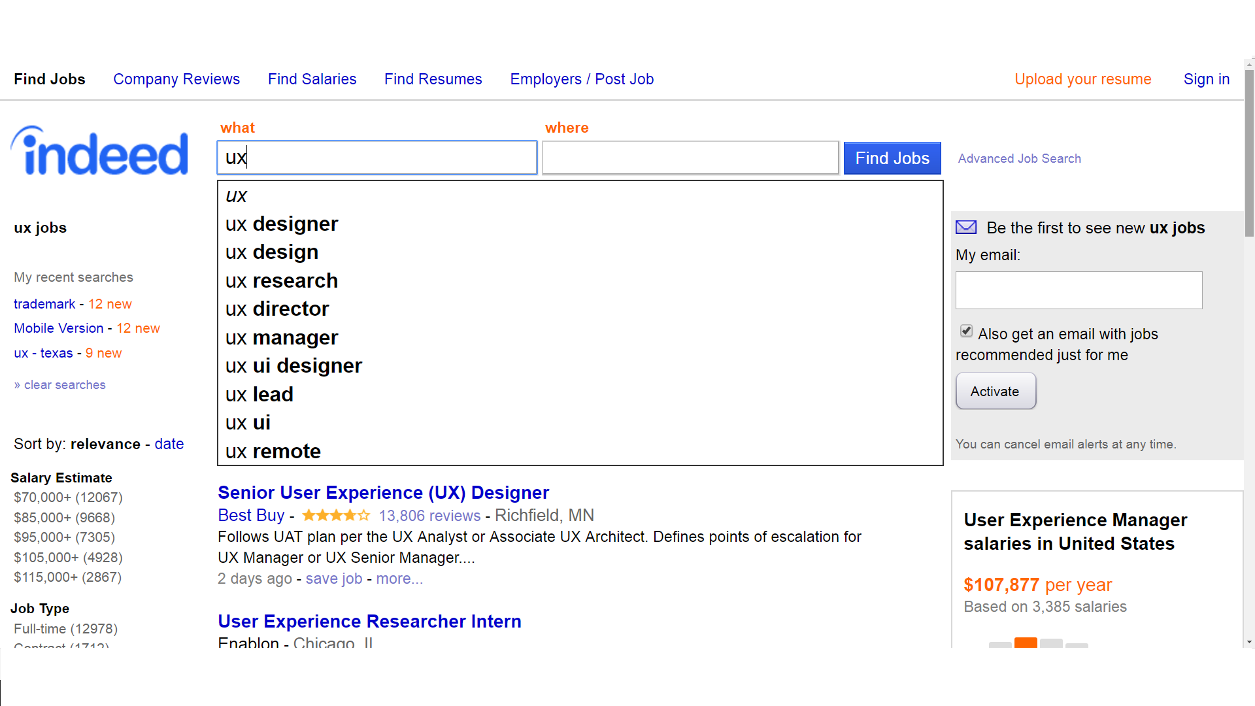
Exclusive features
● Each of the five sites, together with jobs.bg and zaplata.bg, have a major role to play in offering users the opportunity to search for and apply for job advertisements and the ability of companies to post job advertisements. ● What elevates, however, some of the five sites over the others with the same goal is that they are multi-functional, they have unique features that contribute to the overall good experience of their users and these exclusive attributes to them overcompensate their weaknesses. ● Feature I:
An extremely thorough and informative search engine. This feature is inherent to indeed.com, one of the main reasons why the site is so well-known and well-visited, along with the simple and extremely easy interface, this search engine creates a sense of familiarity by working on the same principle as google by showing multiple additional suggestions that complement the already-written job keyword.
This search engine shows additional combinations with the word "ux" not only working positions, but also “ux remote” showing not only the job but the place as well; combined work fields (“ux ui”) and some ux divisions (“Ux research“, “ux director”, “ux manager”).

Slide 10
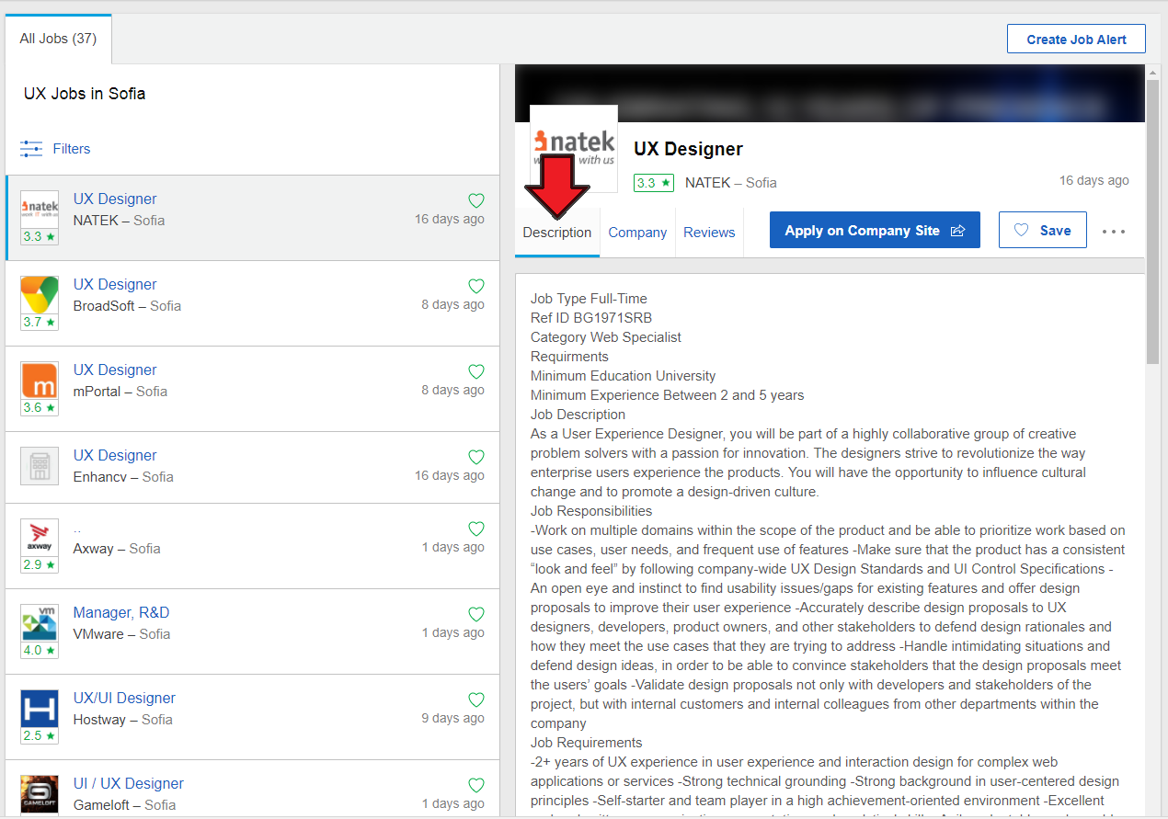
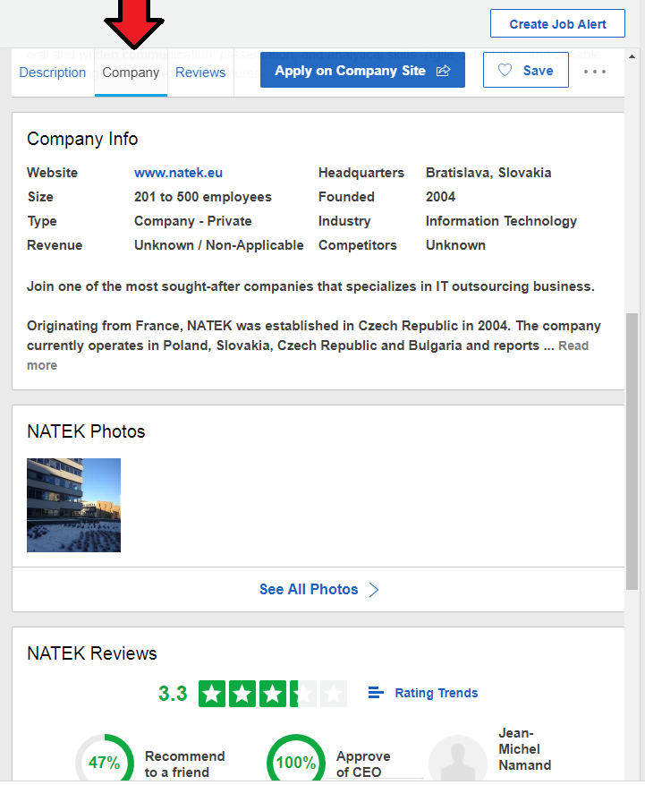
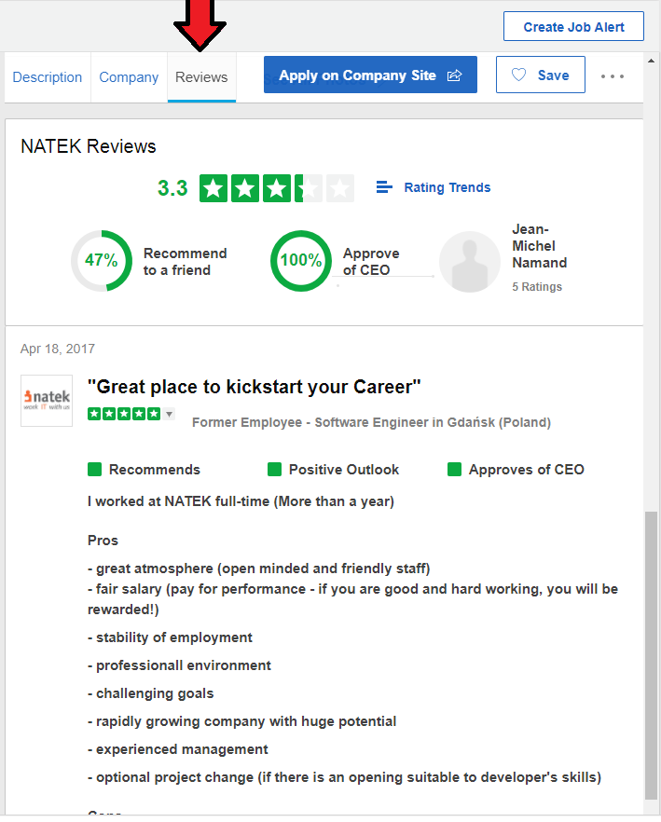
● Feature II:
Additional information about a result after a search (description of the listing, company description, company reviews) - glassdoor.com Again, this is a method that collects multiple potential queries to users on a single page instead of trying to search for (yourself or not) on their own. This feature shows what the ad is showing, shows additional information about the company itself that posted the ad, and shows other people's reviews.

Slide 11
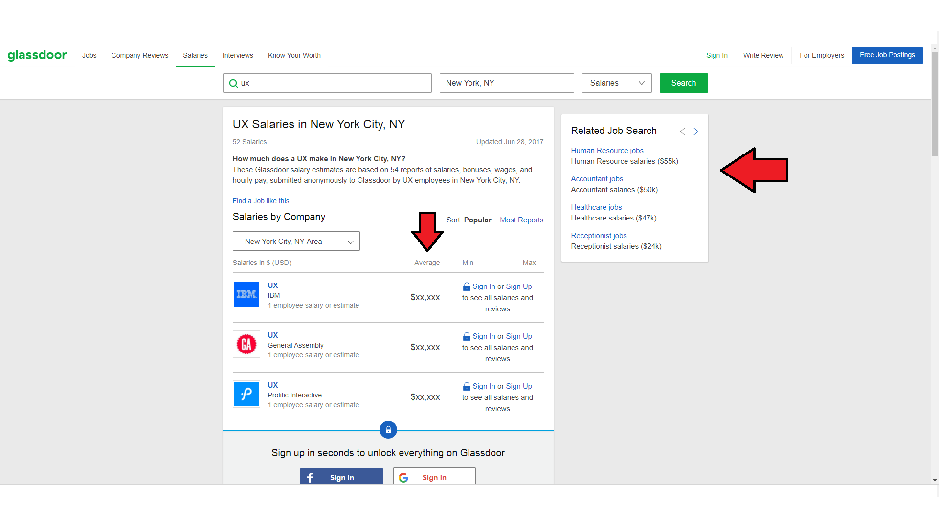
● Feature III:
Payload information - glassdoor.com - A useful add-on that saves time when searching by users and, in the meantime, providing them with important payroll information and how it correlates with pay in the specific workspace in the country.

Slide 12
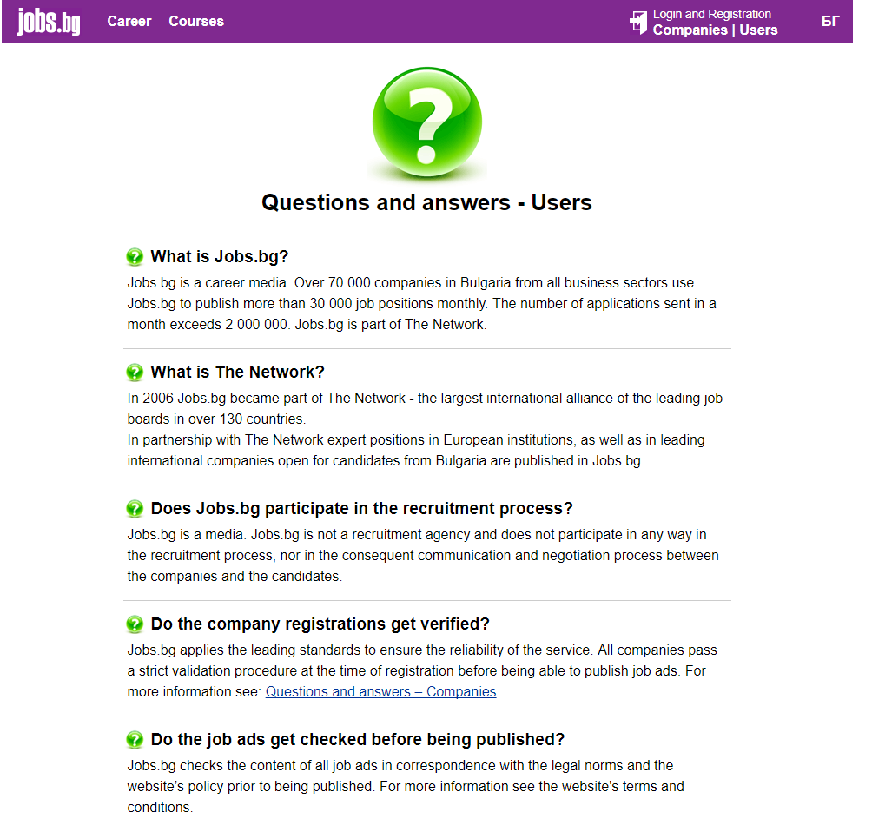
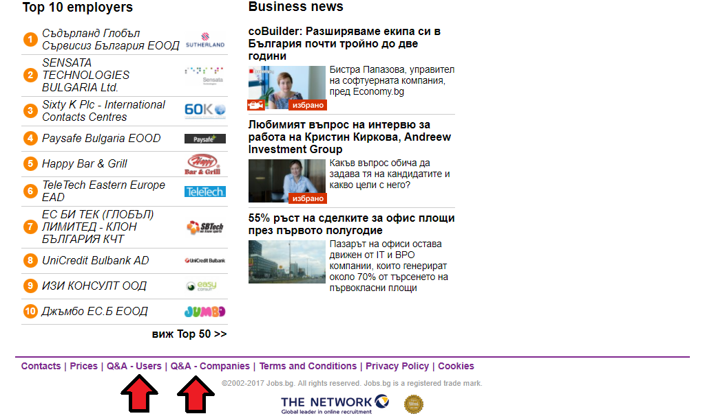
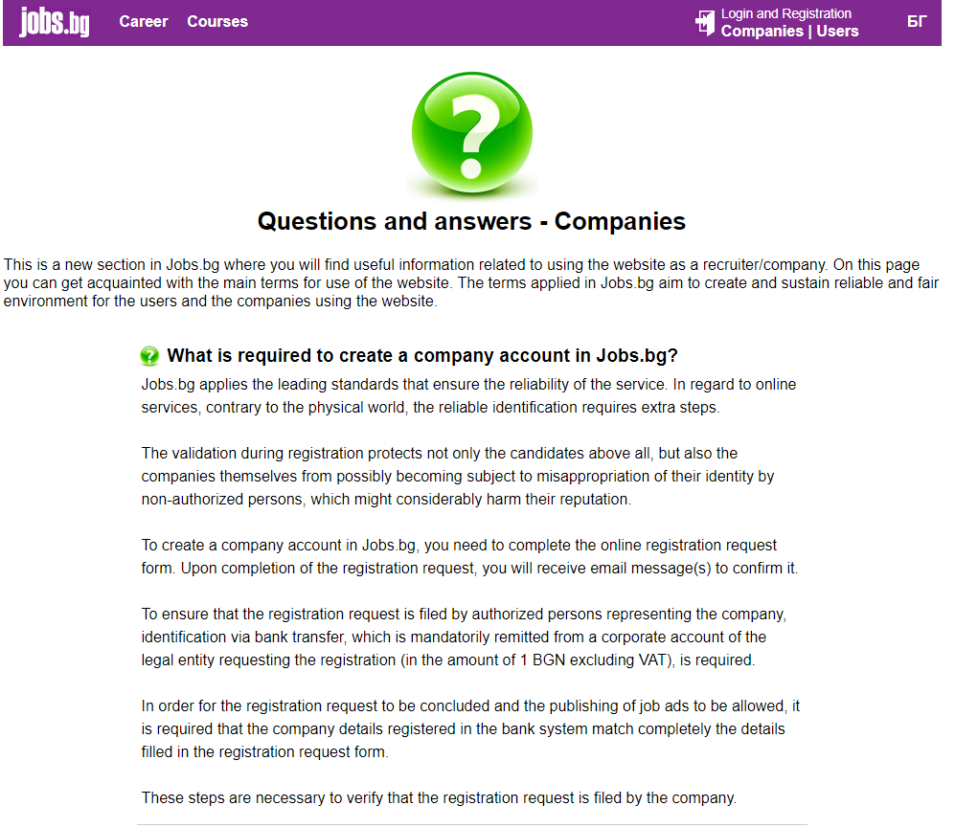
● Feature IV:
1)
After a thorough analysis of the biggest Bulgarian rival of zaplata.bg - jobs.bg, interesting features were found that work better at jobs.bg ● Field for indirect customer service - jobs.bg
2)
This field not only saves time and effort on users and businesses registered on the site who would lose it without experience and waiting for direct contact with the site's help team but also saves time and effort on the team by providing quick FAQ- Response type for both users and businesses. The implementation of these two links saves time and effort on both sides - users / companies and IT specialists/ customer support.

Slide 13
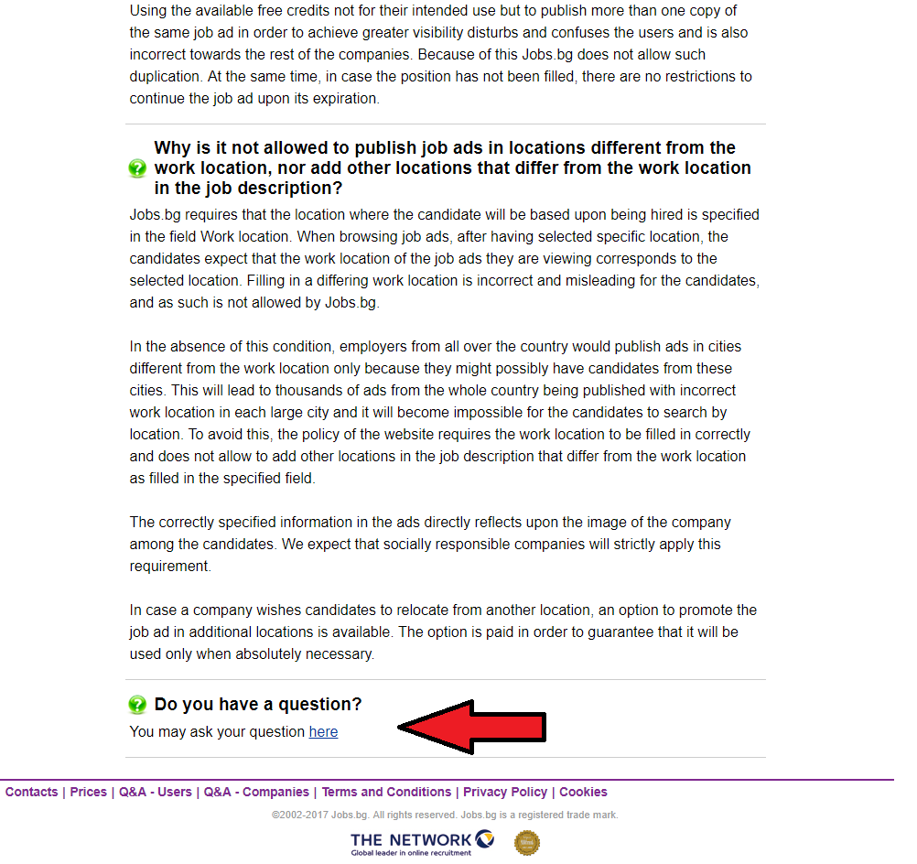
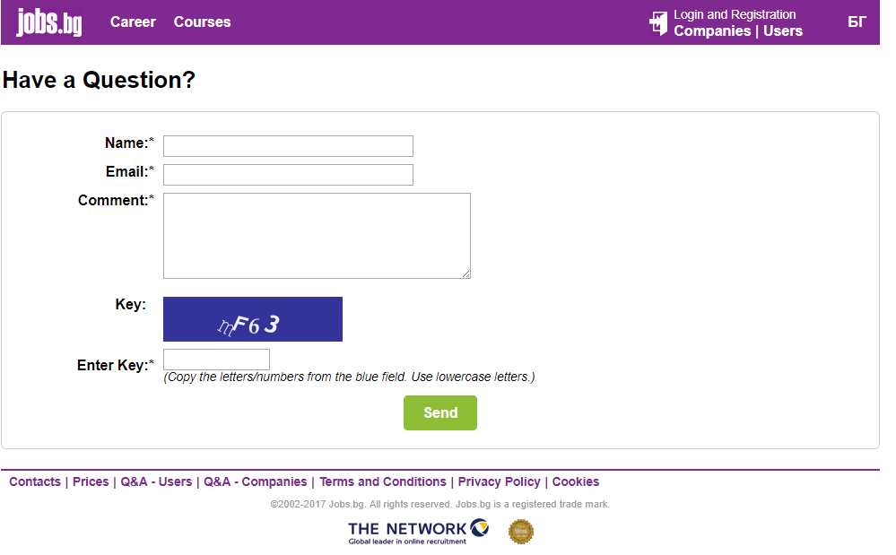
It is important to note that the two pages that are made to answer the most frequently asked questions for users and companies at the bottom have a link to a direct connection with a customer service department, the implementation of such a link at the bottom On both pages shows that the process of offering help is designed entirely to meet the needs of consumers.
Clicking the link for additional help is already leading the user to a direct contact page with the help department, leaving the direct link as the last aid.

Slide 14


Heuristic / comparative analysis of zaplata.bg and jobs.bg
● Things that work: ● Fundamental features of the site work well, do not crash, you can sign up (as an applicant or a company), posting is free with additional paid options. ● The speed according to the test above shows that zaplata.bg loads a bit faster than jobs.bg. ● Optimization in three languages (Bulgarian, English and Russian) while jobs.bg has only two languages (Bulgarian and English) ●The overall design is nice, the size of the text is good, it is read without damaging the eyes, and the choice of dark blue creates a sense of relaxation as this psychological effect is universal. Also, the ads of the company are in the same background as the site logo and the company logo, which helps the site to be remembered and easily recognizable by its users.
● The content of the main page is centrally focused, which contributes to the overall sense of order and draws the attention of the users where it should be. Additionally, the available graphics from other fields in the background of the page are accurately applied, everything seems to be part of a whole, the presence of a white field and the lack of ads contribute to the feeling of affinity and order.

Slide 15
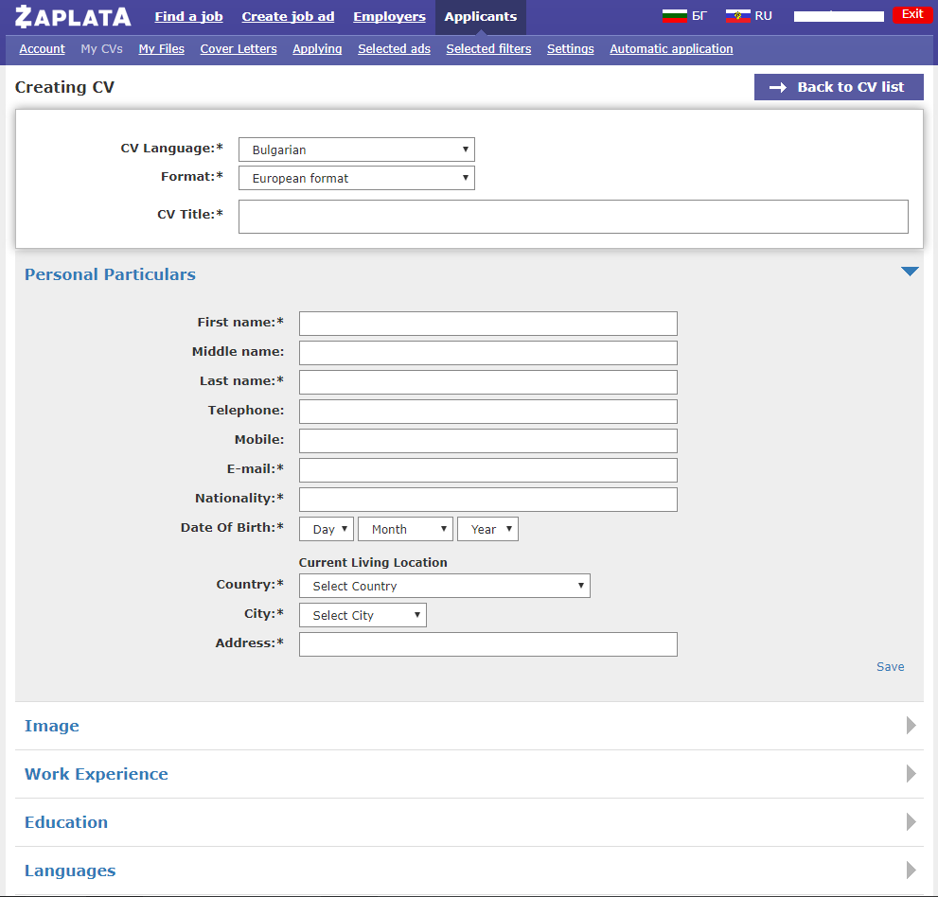
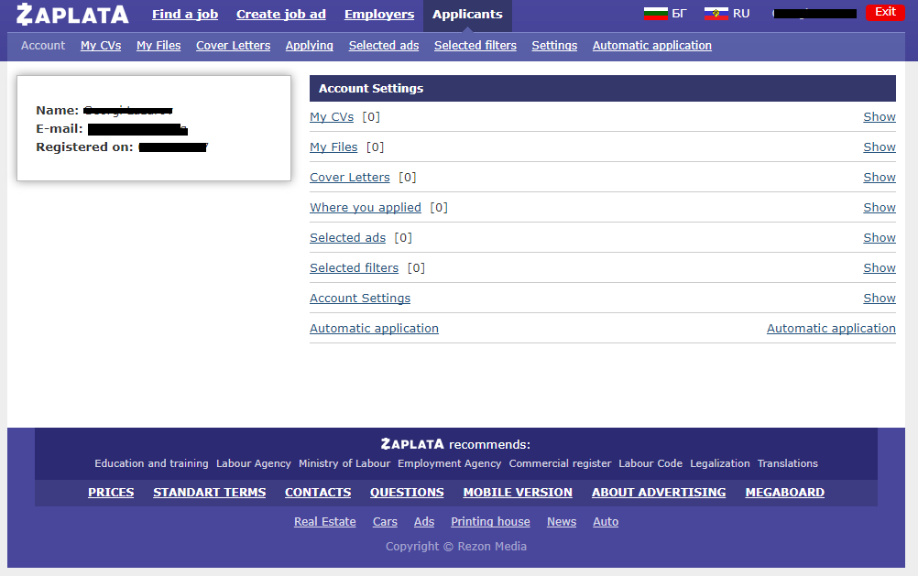
Free CV tools and cover letters are available.
● The personal menu of each individual account is good, with no extra links, easy to use and navigate..
● Additional options are available for selecting specific filters, automatic bidding for selected filters, notices, application history. Functions "selected filters" and "selected ads" are missing in jobs.bg. The personal menu in zaplata.bg with the sameness of the text and its add-ons creates a feeling of greater ordering, unlike jobs.bg

Slide 16
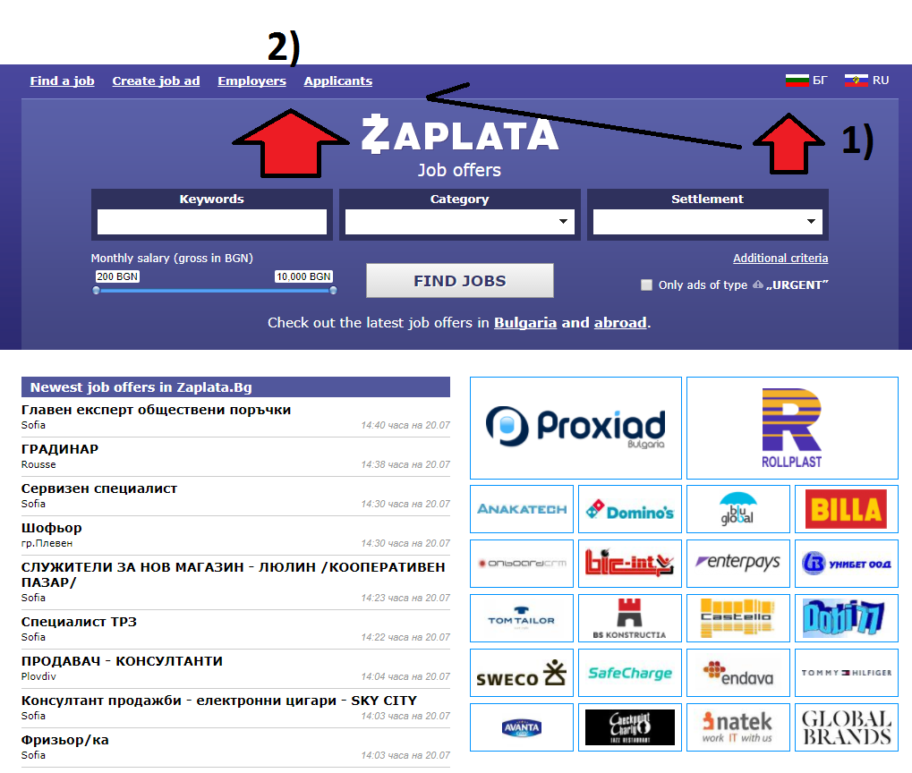
● Things that need fixing:
*On the main page:
● No intuitive user / business input metric (icon / text), this lack creates a sense of disorientation for people who first visit the site or forget it easily.
1) Is the place where most of the signposts are most likely to appear on the profile of most websites, whereas 2) "employers" and "candidates" are the actual links to the site, as there are missing indicators separating them from the other two links - "search" and “publishing”.

Slide 17
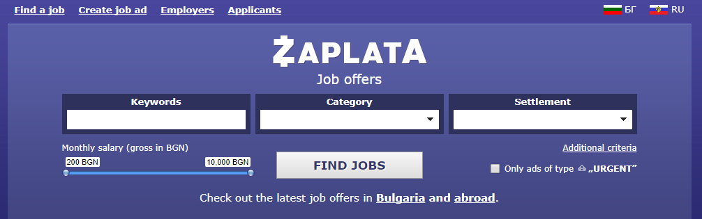
Original design
Suggested design
.
After a click on the signifier icon, a field to the left appears with two links – ‘’Log in ‘’ for employers and candidates which then spawns a new field to insert the username and password so log in can commence on the same page. Even though the suggested design adds one more click of the mouse in order to complete the action, it follows a very widely accepted model of web design, which creates familiarity with the model and therefore easier navigation

Slide 18
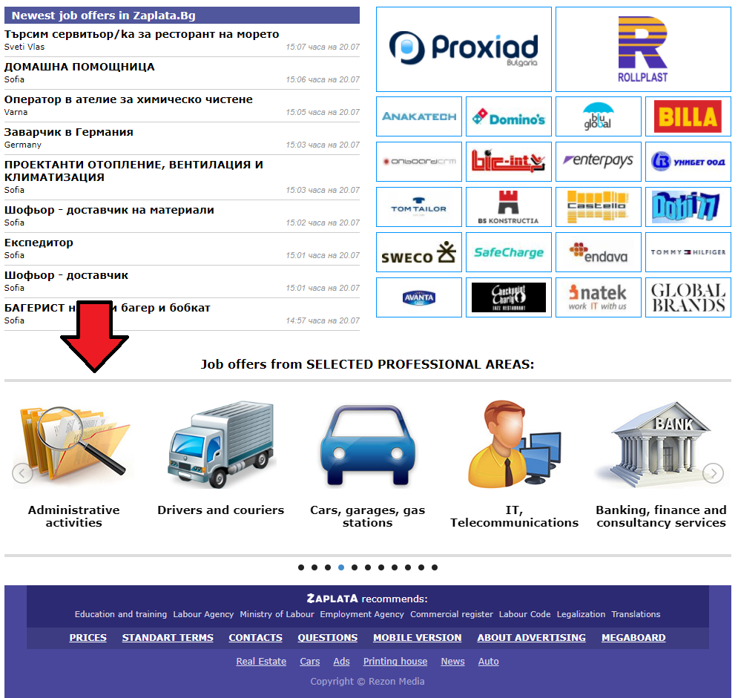
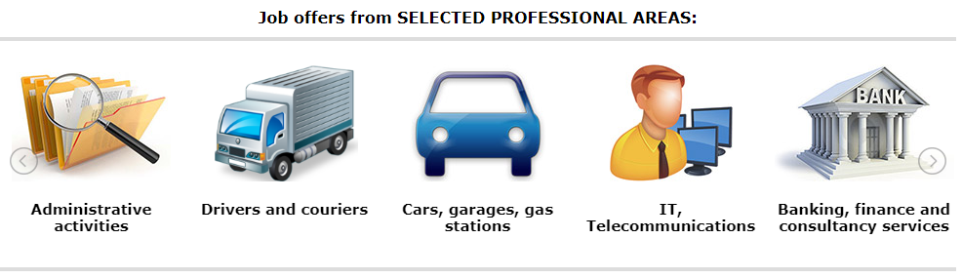
* In the lower part of the main page:
This field is automated, unlike jobs.bg, the automation of this field, ie. Its automatic movement from left to right can create a sense of lack of control in people who carefully choose or read slower, and hence feelings of dissatisfaction
Suggestion: Stop the automated motion of the slides and impelement bigger centrally- placed arrows which are moved by the user himsel, similar to jobs.bg.

Slide 19
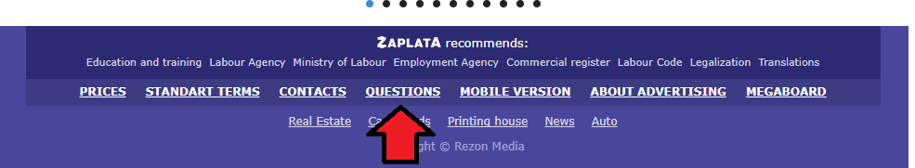
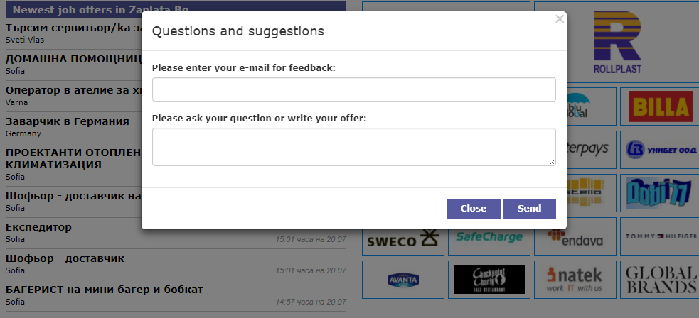
* The link to "questions" leads to a field of direct contact with the site's client support instead of being the last search option in jobs.bg after a section for users / companies with a short FAQ
Proposal: Implement a system similar to jobs.bg, where the most frequently asked questions section is first available and a link to the customer support department is offered at the bottom.

Slide 20
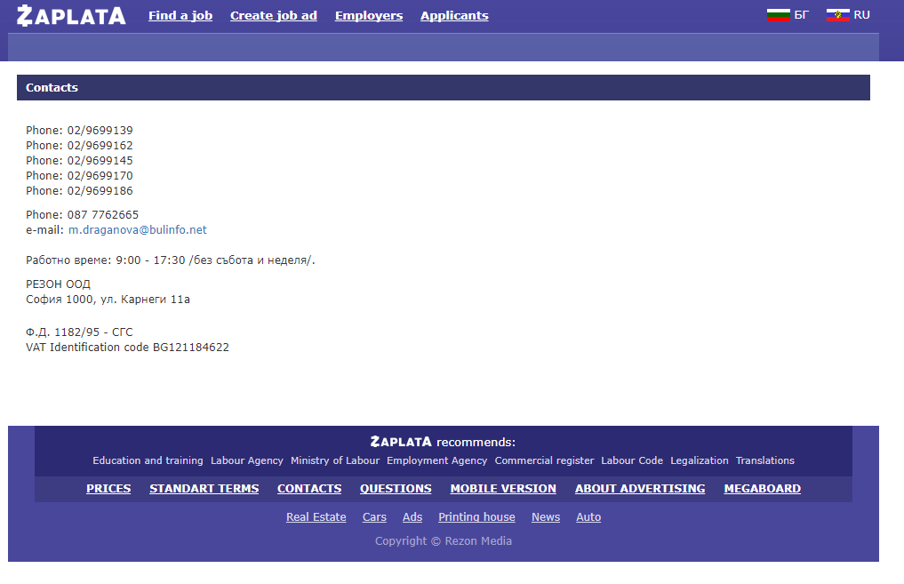
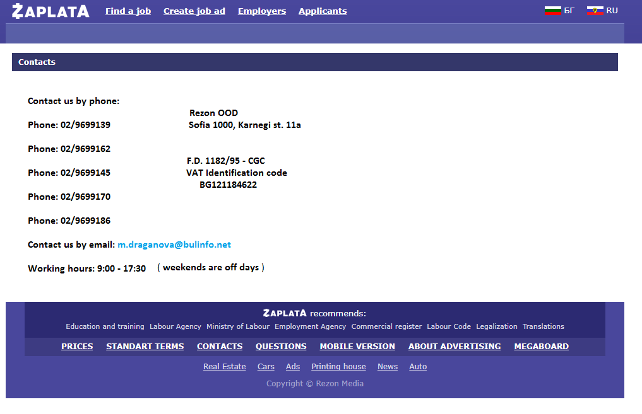
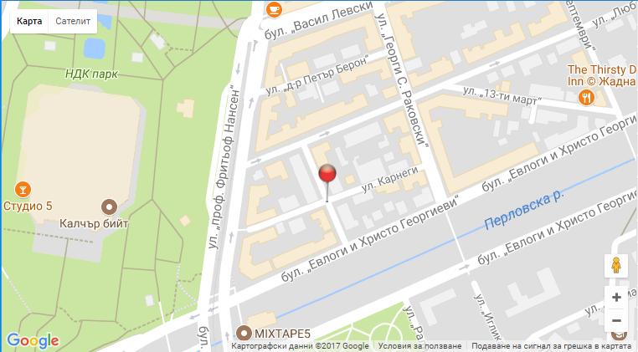
* Link – „CONTACTS“
The link to "CONTACTS" leads to a page that can be aesthetically improved, rather than being intangible text.
Original design
Suggested design

Slide 21
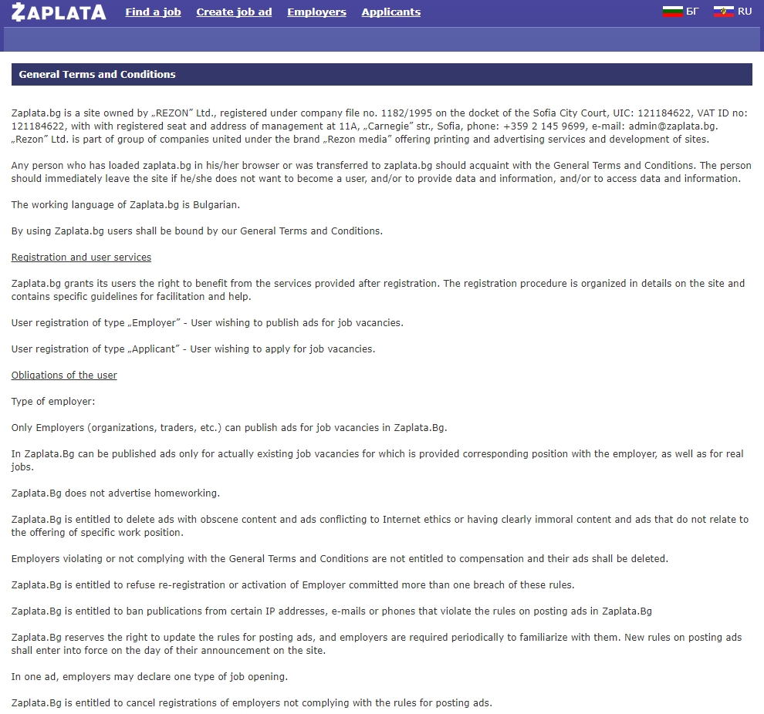
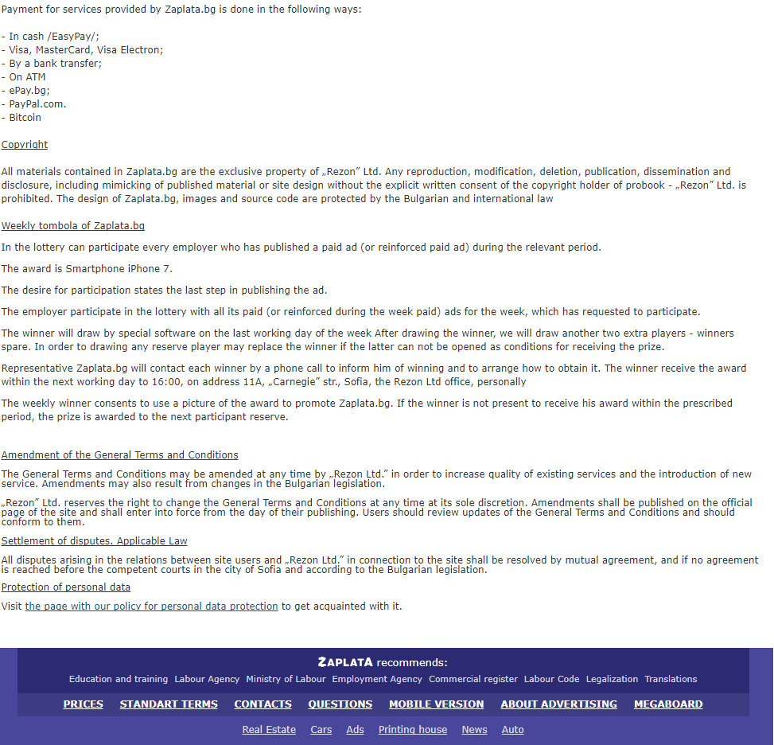
* The link to general terms leads to a page of totally unformatted text that would confuse users and businesses because of the poor location of important information.
Proposal: Transform the whole page of unformatted text into stylized sections with bigger text and better signifiers for the different columns, since the plain text implies to the user that the stakeholders of the site don’t really care whether the website is easy on the eye to their user base.

Slide 22
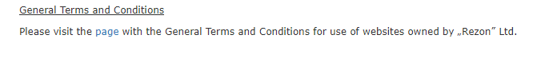
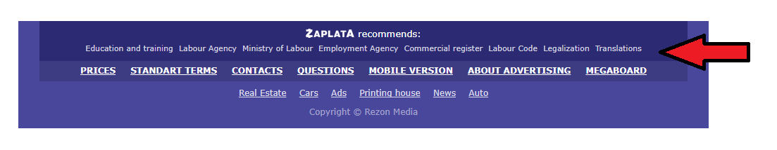
At the bottom of this page there is a link to the privacy policy of the site, whose text is also unformatted and of a small size, this link would be better to move to the main page of the site, under the section "ZAPLATA Recommends "because it is a section of information to which a greater number of people are interested.

Slide 23
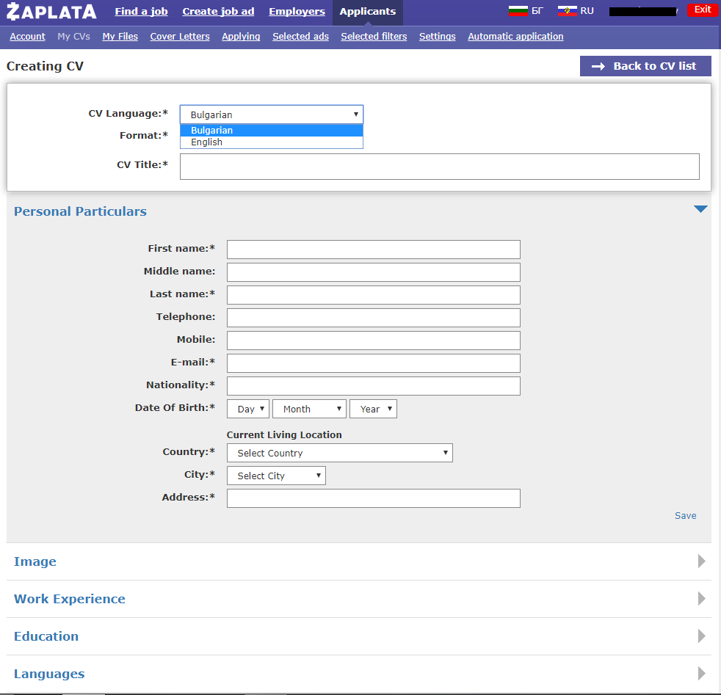
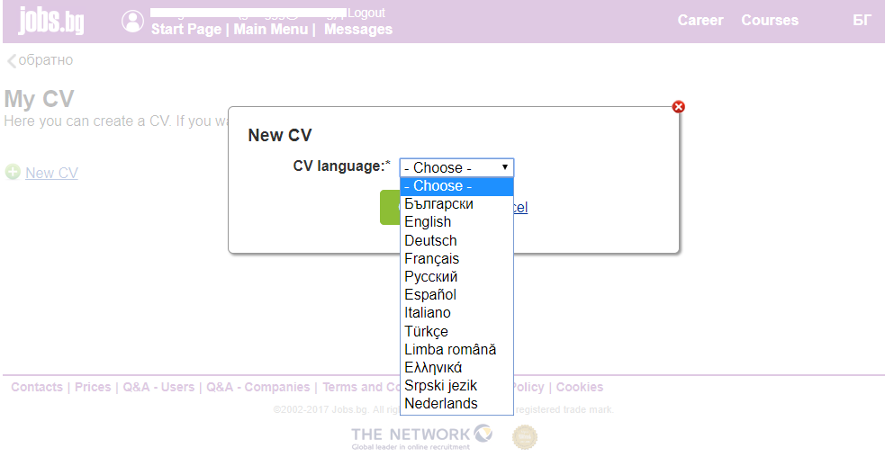
* In profile settings
Need more languages to create a CV in jobs.bg - CV can be written in 12 languages, while in zaplata.bg only two - Bulgarian and English.

Slide 24
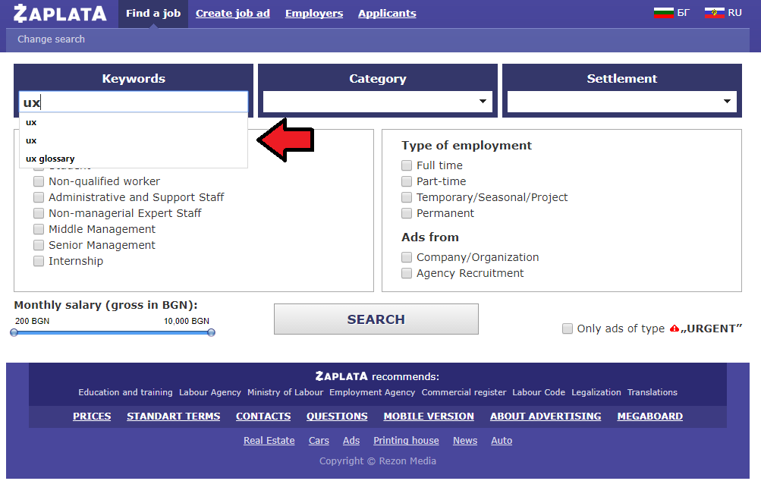
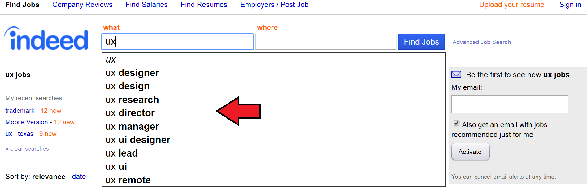
* The search engine
The search engine is neoptimized, showing more results than it should even with applied filters. There is no advanced search function similar to that at really.com, which offers additional words to the original written.
While the search engine at zaplata.bg offers results that are already sought by the user, the really.com search engine offers additional words from its own system, based on google.com.

Slide 25
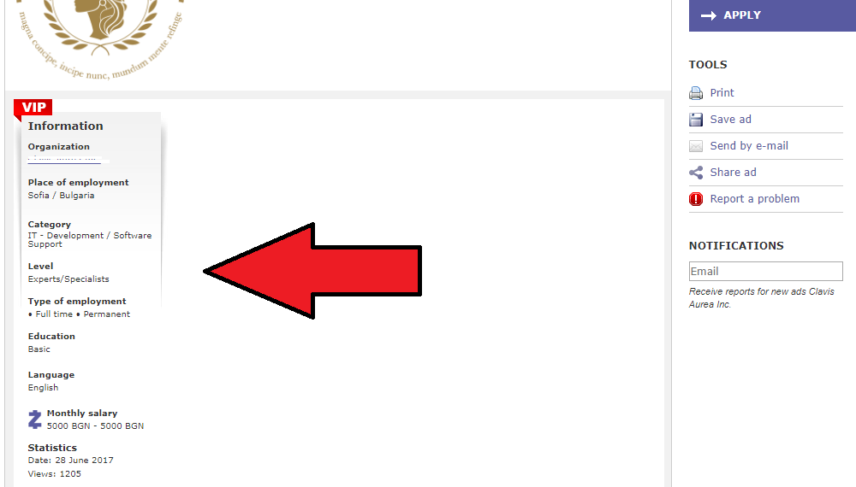
The search results page
In the section providing information about the job ad, the text and icons are too small and are hard to read, the reading of such small text starts to hurt the eyes after a while, and creates a feeling of frustration. Proposal: This entire column of information should be twice as big to make the text easy to read .

Slide 26
* In the mobile app of zaplata.bg
* In the mobile app of jobs.bg
According to the statistics provided by pro.similarweb.com, over 1/3 of the users of the site are using the mobile application (32.39%), with 29/95 people voting on the Android app site, and 2 stars 4 / 95. Total installations - 10,000 - 50,000 . There are complaints related to: Slow or complete absence of page loads when searching for ads. ● The application's lack of follow-up to where the user has gone into the search in the list of ads, when opening an ad and returning to the list of ads, the application returns users to the top of the page rather than where they last arrived before clicking on an ad .
● Lack of active support for the app - According to the Android site, the app was released on October 15, 2015 and its current version is 1.0.
The mobile application of jobs.bg has been downloaded between 100,000-500,000 times as 109/1472 of the voters have given 1 star and 1,603 / 1472 have given the 5 star rating of the device to the android site. ● Extremely slow loading of pages when searching for ads ● Bored automatic return to the main page of the site after an ad review ● Misalignment of search results with the same filters on a computer and phone. ● Unlike zaplata.bg, jobs.bg actively supports their mobile version with frequent new releases, correcting Old problems.

Slide 27
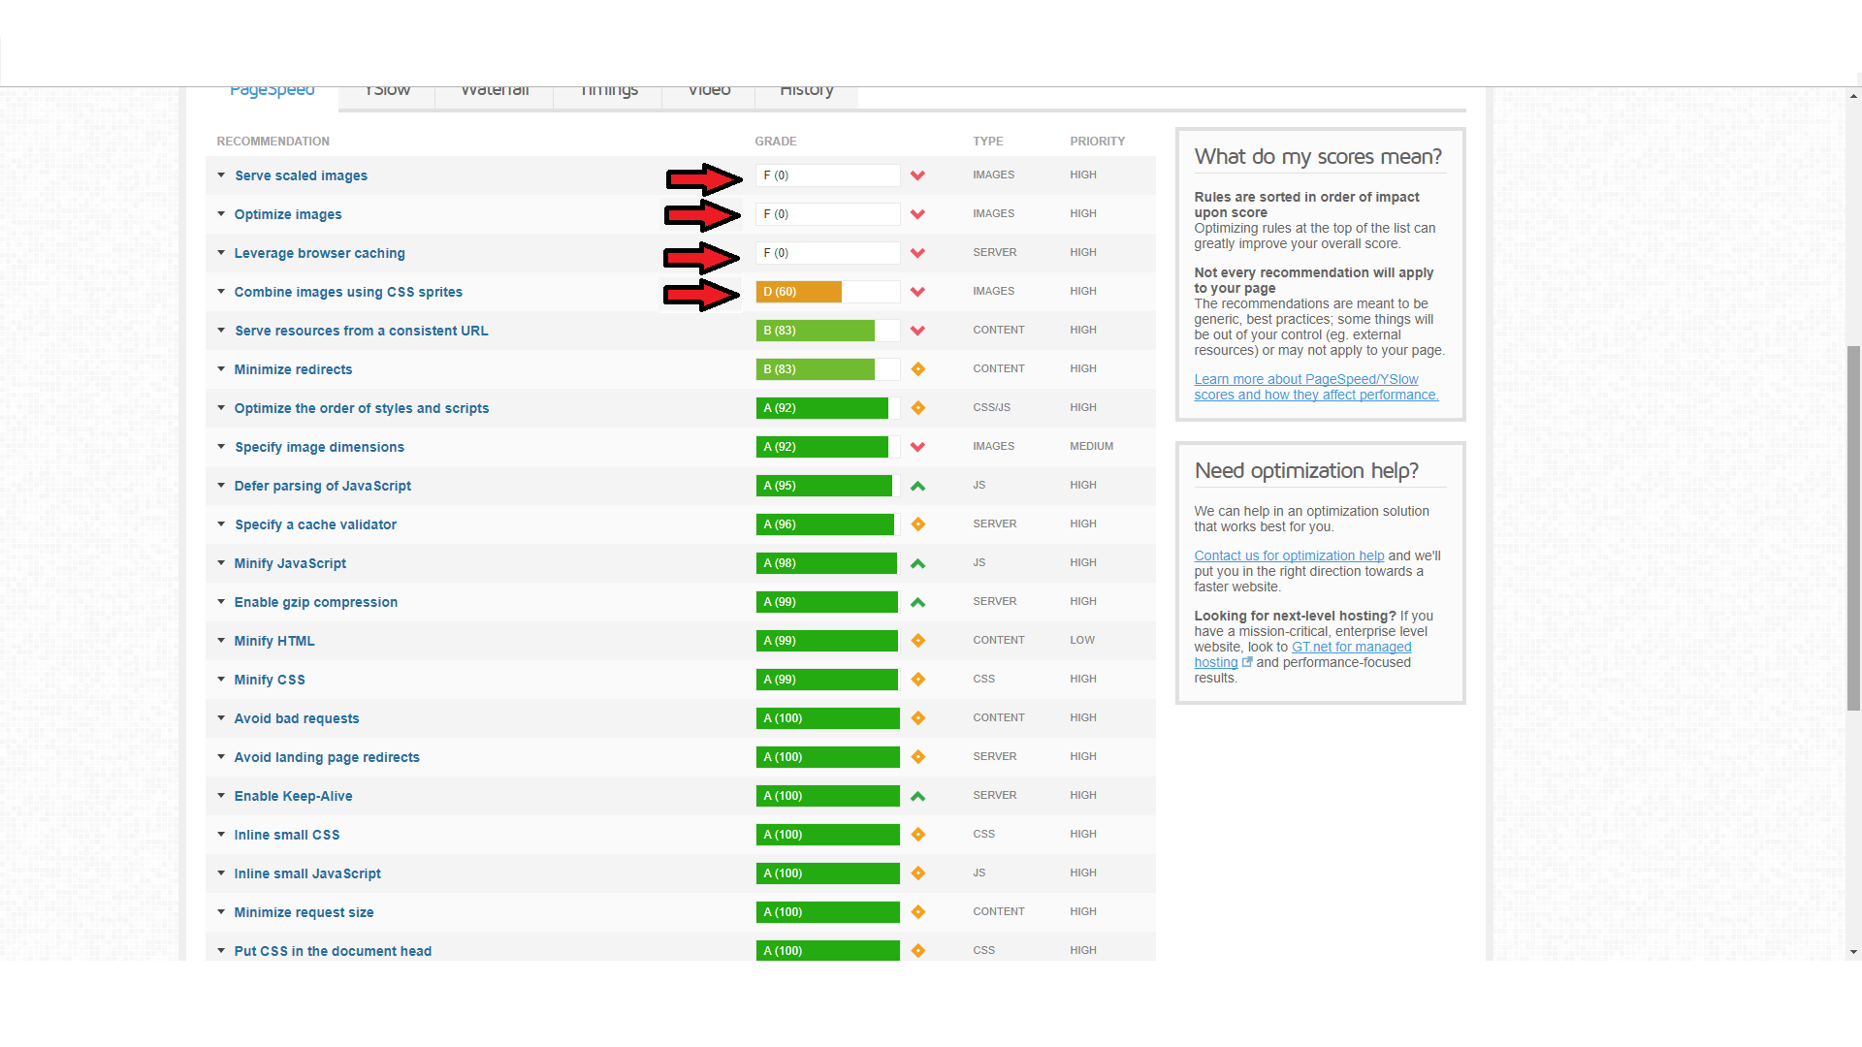
* In a technical aspect
According to gtmetrix's suggestions, zaplata.bg needs serious image optimization on the main page as well as their better size, use of the browser caching function, along with the suggestion to combine css sprite images. As well as mild proposals to reduce the number of edits, with these edits the site's speed would be greatly improved.

Slide 28
Short Overview
Zaplata.bg is a website with excellent fundamental features, good speed, good language optimization, its design is well made and memorable. It has features inherent in the most widely used sites in the field of employment and jobs. Zaplata.bg, however, has problems with certain pages and their formatting, there are shortcomings in the function of making CVs and cover letters, the login field for users and companies is relatively disorienting and there are some problems with image optimization on its main page . If the proposed solutions are implemented, the site will get a better aesthetic and functional look, and it will be easier for users and firms alike to work with it, furthermore the user support will be easier on the support team as well. Of course, if it’s possible, a powerful search engine, like the one in indeed.com, should be implemented, as well as addition information like reviews and fundamental information about the companies who post job ads, in a similar fashion like glassdoor.com. If these exclusive features are provided for the website, zaplata.bg will attain a dominant position, in a functional aspect over any other website in the field of job seeking and employment in Bulgaria.

